Slide 1
> Shay Konradsdottir
> A basic AI generated sorter.
>
Start Presentation

Slide 2
> Highlights:
>
Computer-Generated Code
Comparable to DNA
AI Sequence to Program
Nucleotides:
ATTAAAGGTTTATACC
+ active++;
Q current.enqueue(active);
P current.priorityEnqueue(active);
D active = current.dequeue();
V if (active >= 0 && active < input.length) {
N current = nextQueue();
v } else {
+ active++;
A active += current.dequeue();
+ active++;
+ active++;
Q current.enqueue(active);
N current = nextQueue();
- active--;
D active = current.dequeue();
O print(active);
v }
AI Sequence:
+QPDVNv+A++QN-DO
Built up with a stack
A,5
P,1
+,4
V,1
+,3
Q,2
D,1
+,0
+PVv+D+Q+
A,5
+PVv+AD+Q+

Slide 3
> System Diagram: Sequence and AI
Sequence
Builds a stack of AI elements similar to strands of DNA for editing purposes. This enables easy modifications utilizing insertion by index.
- sequence : Stack<SequenceItem>
- currentBrain : string
- rand : Random
+ new(complexity : int = -1) : Sequence
+ new(text : string) : Sequence
+ copy() : Sequence
+ baby(complexity : int = -1) : Sequence
+ getComplexity() : int
+ deleteElement(index : int = -1)
+ addRandomElement()
+ save() : string
+ addElement(top : SequenceItem)
+ addElement(c : char, index : int)
+ build() : AI
AI
Creates a logic tree using a ‘brain’ string and can create an enumerator for sorting a problem.
- input : int[]
- brain : LogicTree
- brainString : string
- decode : Dictionary<char, string>
- formatHelper(node : TreeNode) : string
+ new(brain : string) : AI
+ loadInput(input : int[])
+ getEnum() : AIEnumerator
+ toStringFormatted() : string
+ toString() : string
Logic Tree
A simple BST, where the logic placements are questions that ask the AI’s current state. Questions such as, “Is the active value a valid index in the input array?”

Slide 4
> Reg
e
r
t
rets:
s
Mistakes:
Didn’t make a System Diagram before starting.
Halfway through, decided to make a ‘delete’ in stack that effects deeper-than-top elements.
AI has too many functions, so learning becomes more difficult.
Taught AI to think for itself, and it attempted to overthrow humanity.
Aspirations:
Allow AI to ‘breed’ with another copy of itself.
Design Educator to build a better AI with better incentives and punishments.
Make a better evolutionary protocol than “Random modifications”.

Slide 5
> Accomplishments:
Saving/Loading Sequences:
Prior to this project, I have never made a program like this that I could save/load the AI with. This was a huge accomplishment to me, and taught me a lot about how to pass data between data structures..
No Stack-Fear:
I used to be unfamiliar with stacks in C#. I elected the AI Sequence to be a stack so I’d be more exposed to it. I learned to overcome my stack-fear, and am more comfortable with stacks.
Unity GUI:
I’m a fan of using Unity for graphics, but it’s very memory heavy and causes a lot of issues on my laptop. I learned to build a GUI in Unity that wasn’t difficult to edit on my old laptop.

Slide 6
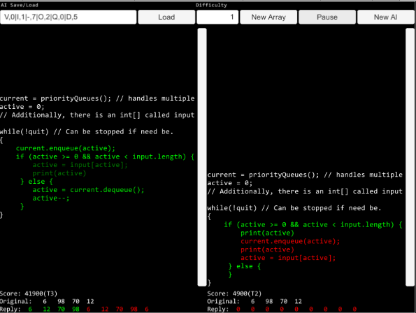
> Unity GUI:
Buttons
Save String
AI Champion
Newly Generate AI
Educator Data

Slide 7
>
end Presentation

